Slide 1


Trip-duration
Prediction Report
New York Taxi
NYC TAXI

Slide 2



Objectives
Understanding CRISP-DM
1
Example
CRISP-DM Implementation
2

Slide 3
Table of Contents
 | Page
CRISP-DM Explanation
Business Understanding
Data Understanding
Data Preparation
Modelling & Evaluation
Conclusion

Slide 4

CRISP-DM

Slide 5

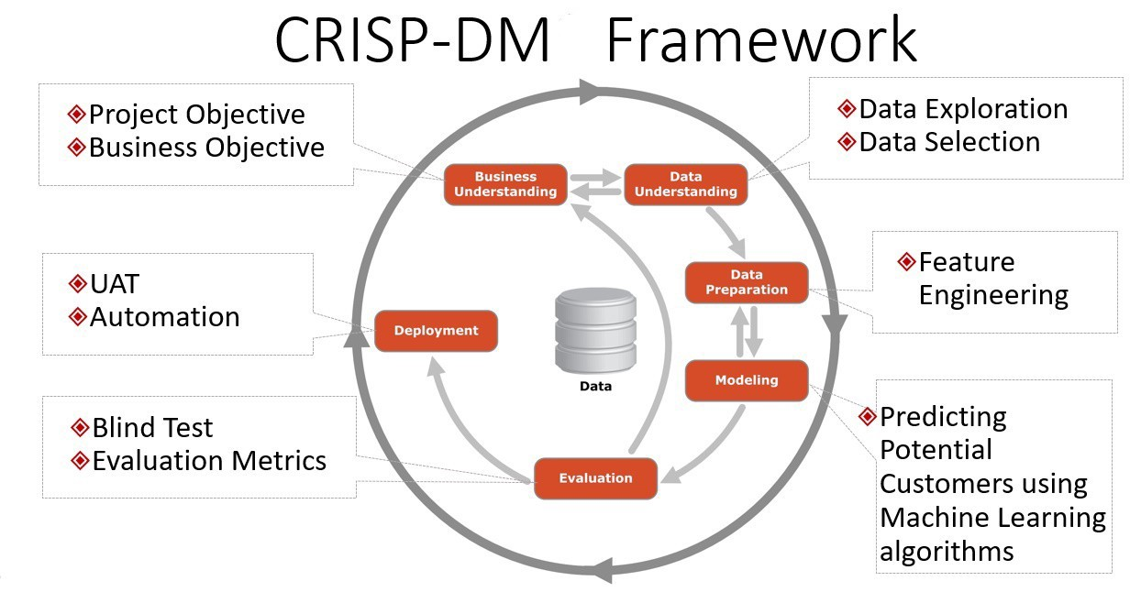
What is CRISP-DM?
Random forest regressor is the ensemble algorithm of machine learning to continuous prediction. This is for regression problem.
Cross-Industry
Standard Process for
Data mining

Slide 6
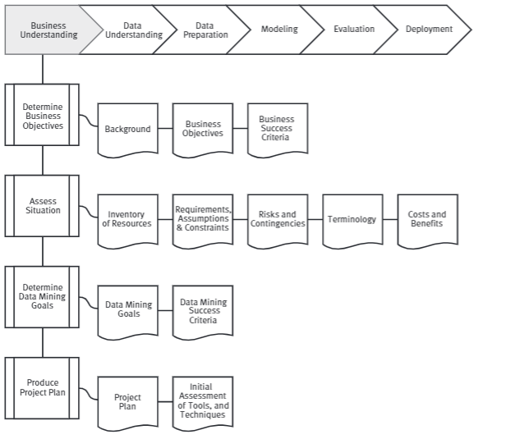
Business Understanding
Looking for problem base on business perspective.
Define decision base on problem that you find
Looking for information that needed to inform those decision
Determine type analysis can provide the information needed to inform those decisions
Random forest regressor is the ensemble algorithm of machine learning to continuous prediction. This is for regression problem.

Slide 7
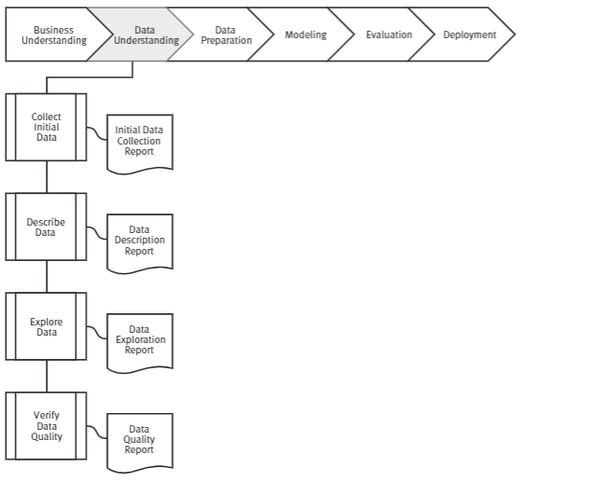
Data Understanding
Initial data collection and proceeds with activities in order to get familiar with data,
To identify data quality problems and that’s characteristics
Discovered first insights into the data or to detect interesting subset to form hypotheses for hidden information
Random forest regressor is the ensemble algorithm of machine learning to continuous prediction. This is for regression problem.

Slide 8
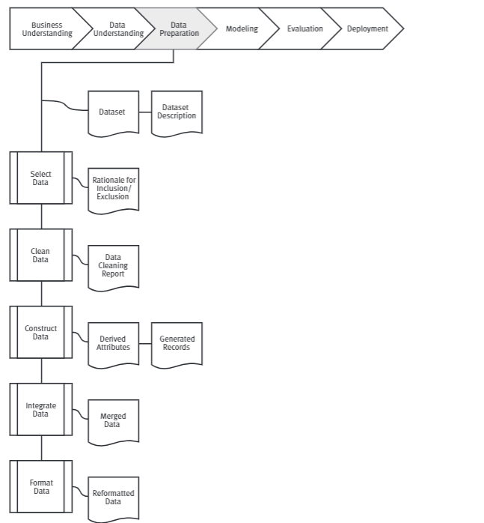
Data Preparation
Random forest regressor is the ensemble algorithm of machine learning to continuous prediction. This is for regression problem.
In this step we build dataset to make modeling from raw data.
We can iterate step until data is clean and great to make modeling.

Slide 9
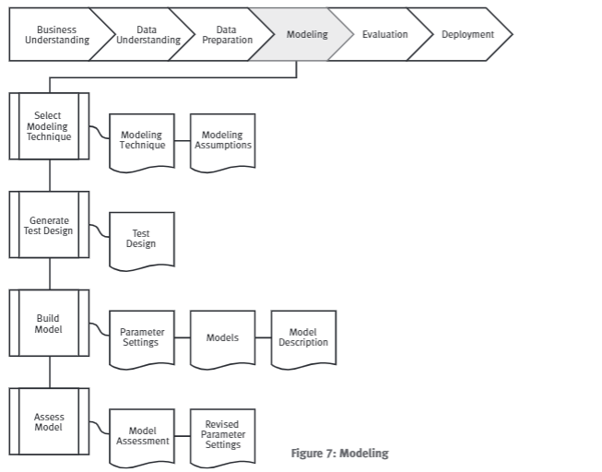
Modelling
Determine what methodology to use to solve the problem
Determine the important factors or variables that will help solve the problem
Build a model to solve the problem
Run the model and move to the evaluation phase
Random forest regressor is the ensemble algorithm of machine learning to continuous prediction. This is for regression problem.

Slide 10
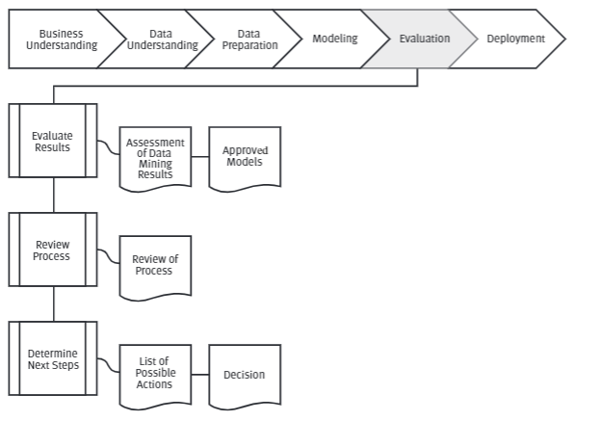
Evaluation
To checking the quality model objectively and how effective model to solve the problem
Observe the key results on the model
Ensure the results make sense within the content of the business problem
Determine whether to proceed to the next step or return to a previous phase
Repeat as many times necessary
Random forest regressor is the ensemble algorithm of machine learning to continuous prediction. This is for regression problem.

Slide 11
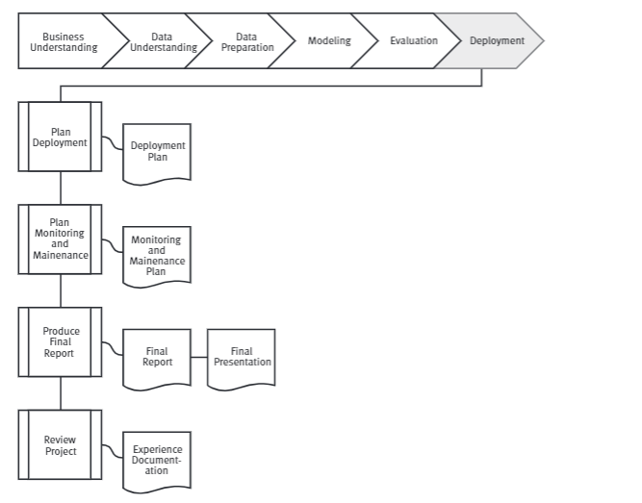
Deployment/Presenting
Knowledge gained will need to be organized and presented in a way that the customer can use it. However, depending on the requirements, the deployment phase can be as simple as generating a report or as complex as implementing a repeatable data mining process across the enterprise.
Random forest regressor is the ensemble algorithm of machine learning to continuous prediction. This is for regression problem.

Slide 12
IMPLEMENTATION
CRISP-DM

Slide 13
Business
Understanding

Slide 14
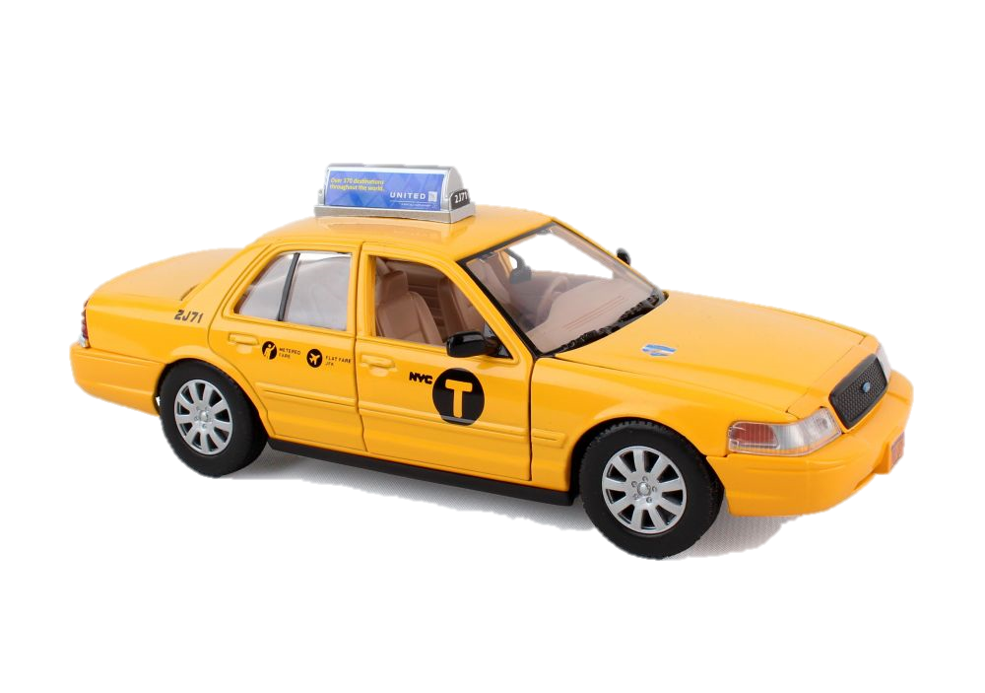
Business Problems
The New York City taxicab had humble beginnings. When the “traditional” metered, gasoline-powered taxicabs began operating in October 1907, they were in tough competition with other forms of transportation throughout the city.
Nowadays, in the era of online
transportation and application,
one of the important thing that
passenger need is the accurate
trip duration information in the application.
Providing accurate information about ETA is very challenging given road conditions and uncertain circumstances.

Slide 15
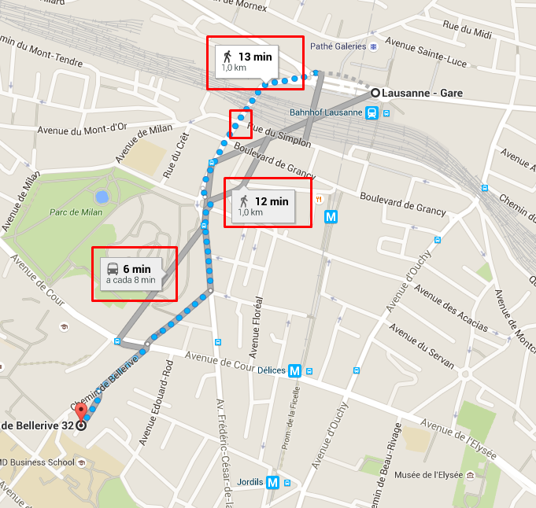
Objectives
Predict trip duration
in real time

Slide 16

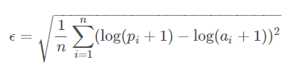
Root Mean Square Logarithmic Error (RMSE)
Success Criteria
Root mean square logarithmic error is quadratic scoring rule that also measure the average magnitude of the error. It’s the square root of the average of squared difference between prediction and actual observation with logarithmic condition.
ϵ = is the RMSLE value(score)
n = the total number of observations in the (public/private) data set,
pi = is your prediction of trip duration
ai = is the actual trip duration for i.
log(x) = is the natural logarithmic of x
https://medium.com/human-in-a-machine-world/mae-and-rmse-which-metric-is-better-e60ac3bde13d

Slide 17
Data
Understanding

Slide 18
Original Data
Data train
Data test
id
Vendor_id
Pickup_time
Dropoff_time
Passenger_count
Pickup_latitude
Pickup_longitude
Dropoff_longitude
Dropoff_latitude
Store_and_fwd_flag
Trip_duration
id
Vendor_id
Pickup_time
Passenger_count
Pickup_latitude
Pickup_longitude
Dropoff_longitude
Dropoff_latitude
Store_and_fwd_flag
Trip_duration

Slide 19
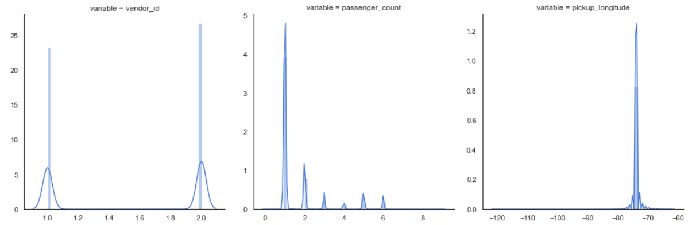
Distribution of Variables (train)
After use np.log

Slide 20
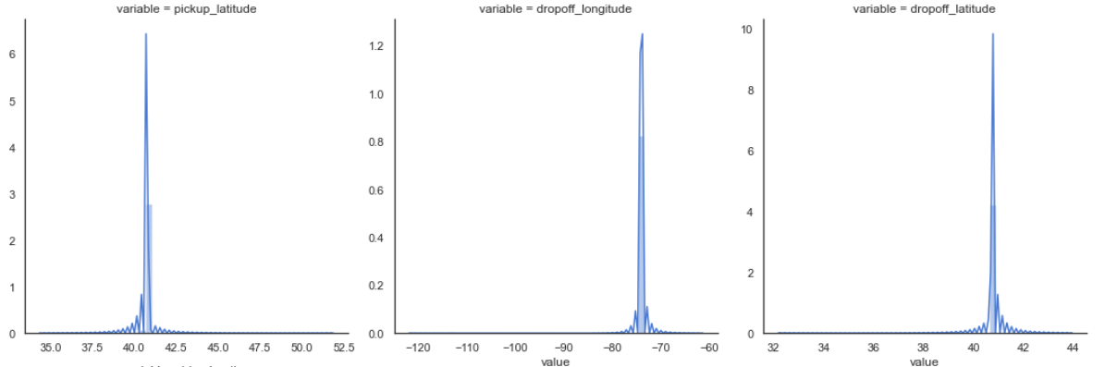
Distribution of Target Variables (train)

Slide 21
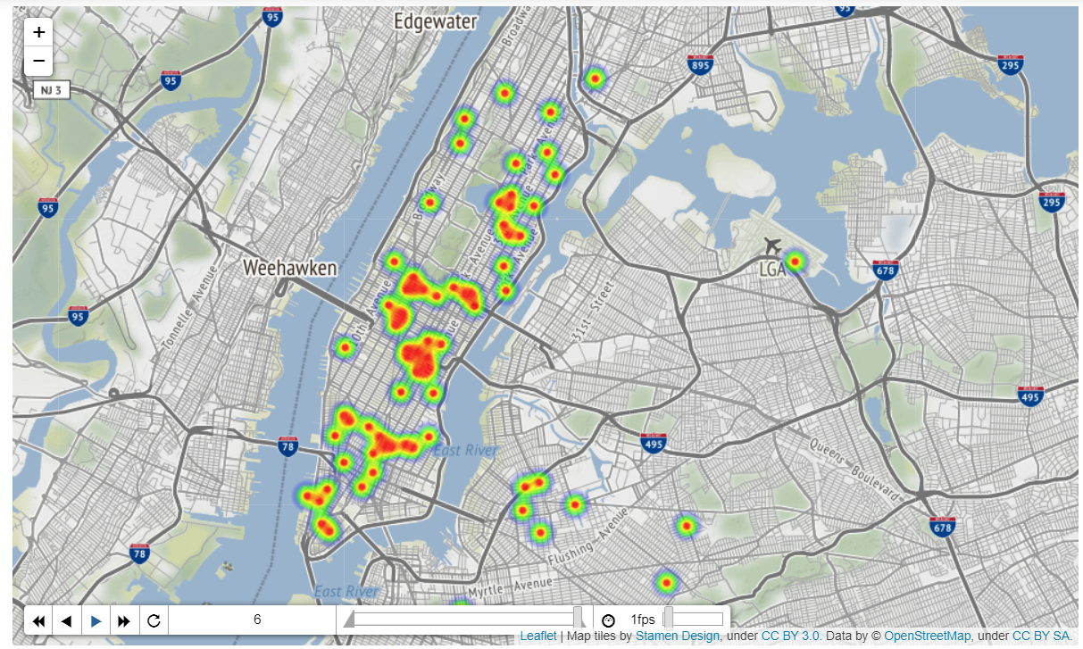
Distribution of Target Variables (train)

Slide 22
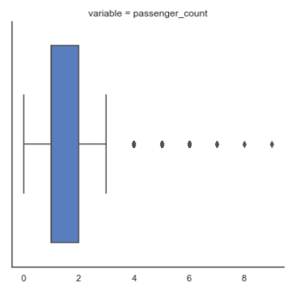
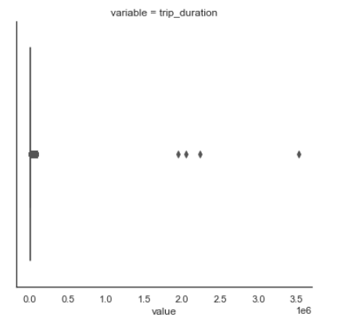
Outliers of Target Variables (train)

Slide 23
Adding New Data
Data train
Data test
Hour
Month
weekofYear
dayofMonth
dayofWeek
distance_haversine
distance_dummy_manhattan
direction
Hour
Month
weekofYear
dayofMonth
dayofWeek
distance_haversine
distance_dummy_manhattan
direction

Slide 24
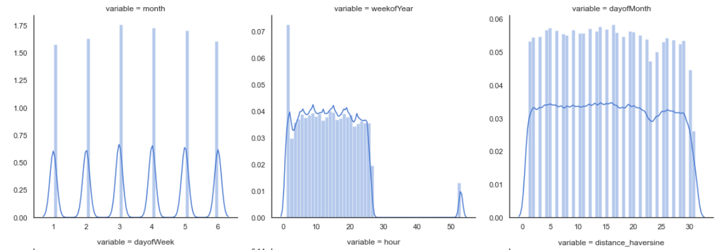
Distribution of Target Variables (train)

Slide 25
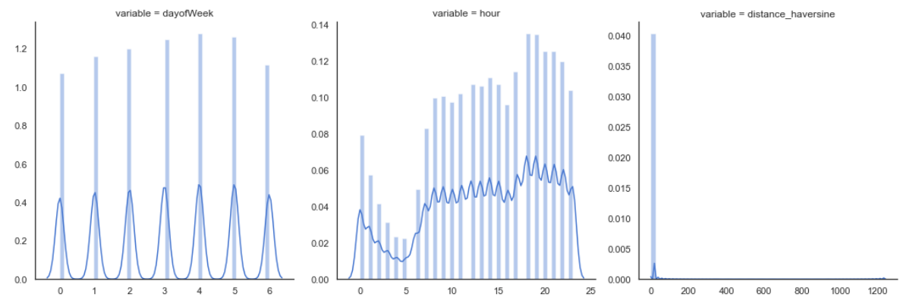
Distribution of Target Variables (train)

Slide 26
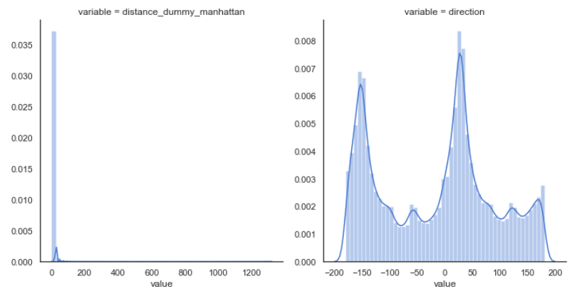
Distribution of Target Variables (train)

Slide 27
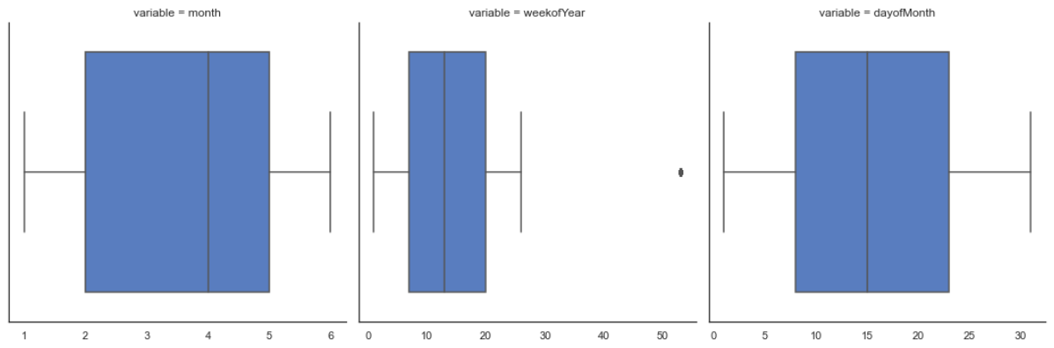
Outliers of Target Variables (train)

Slide 28
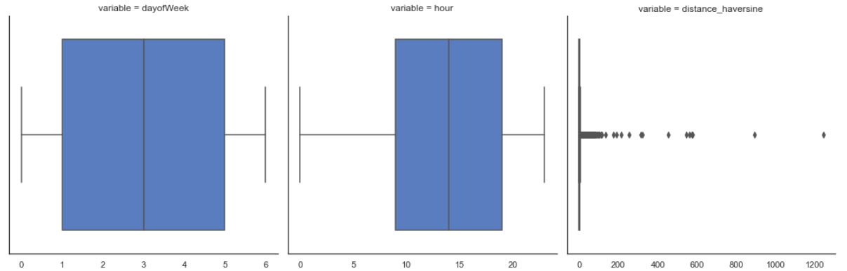
Outliers of Target Variables (train)

Slide 29
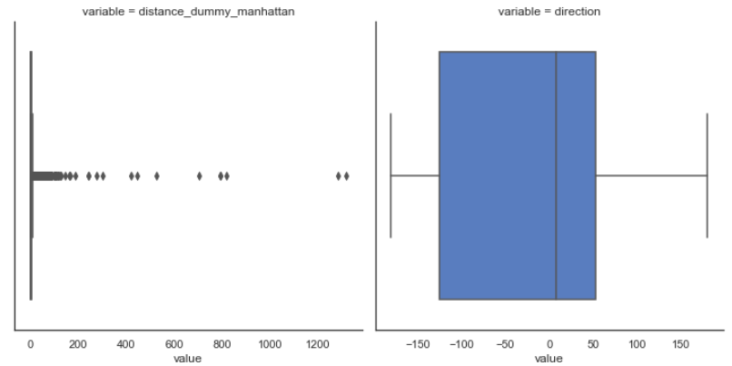
Outliers of Target Variables (train)

Slide 30
Data
Preparation

Slide 31
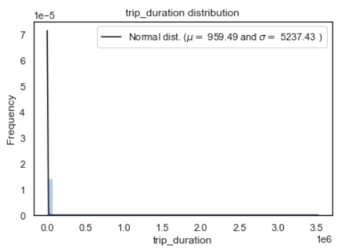
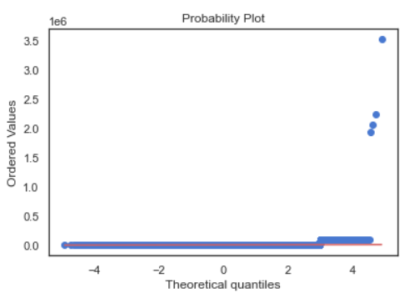
Distribution of Target Variables (train)

Slide 32
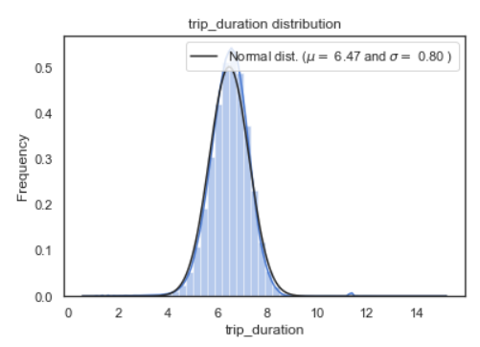
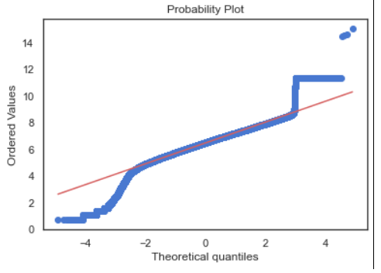
Distribution of Target Variables (train)
After use np.log to normalize

Slide 33
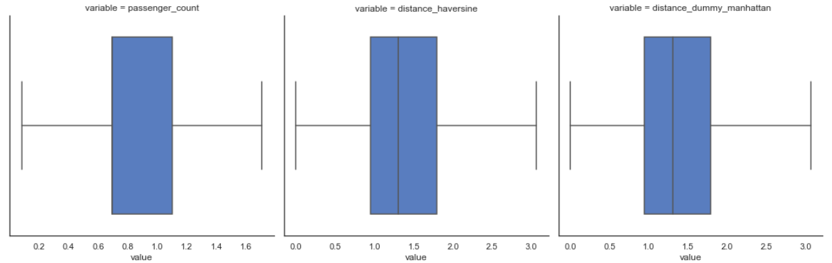
Outliers of Target Variables (train)
After capping data

Slide 34
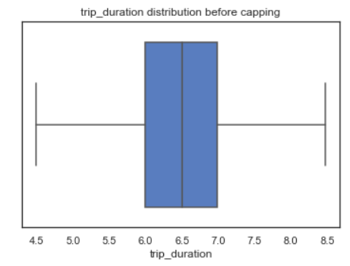
Outliers of Target Variables (train)

Slide 35
Modelling
&
Evaluation

Slide 36

Modelling Technique
LightGBM Regresor
CatBoost

Slide 37


LightGBM Regressor
CatBoost
LightGBM Regressor is a gradient boosting framework that use tree based learning algorithm to regression oriented. It is to be distributed and efficient with the following advantages:
CatBoost or categorical boosting is a machine learning algorithm that uses gradient boosting on decision trees. It is available as an open source library.

Slide 38
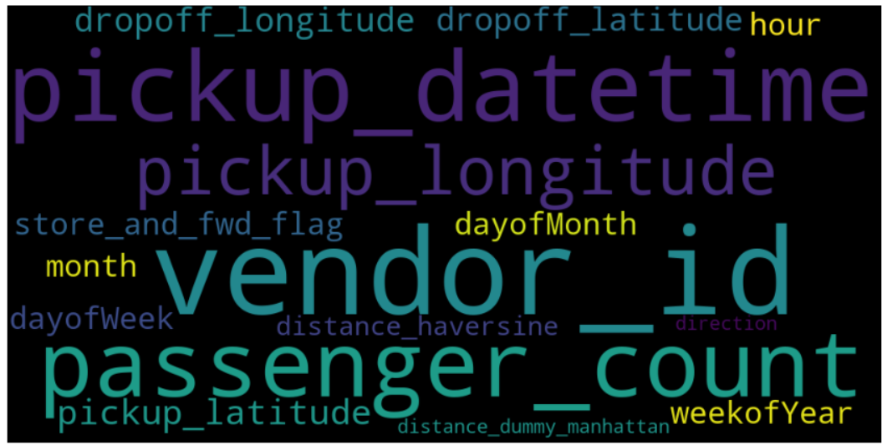
16 Features

Slide 39
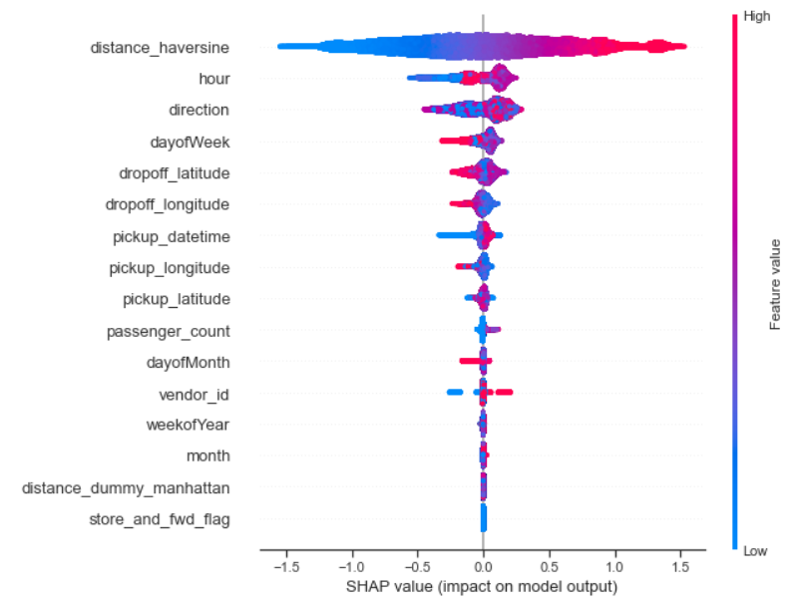
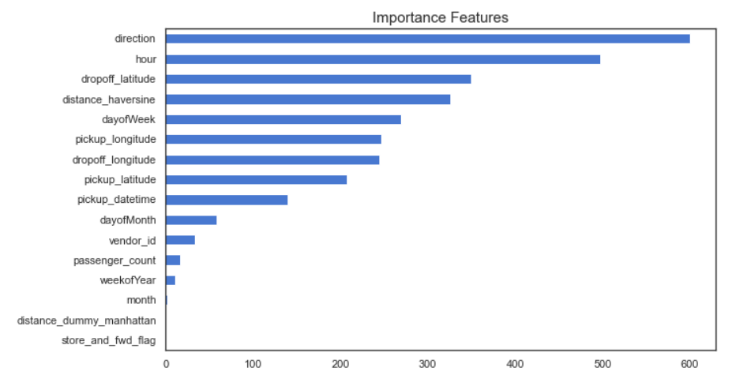
LightGBM Result
train | Test | MALE | MSLE | RMSLE
0.78 | 0.78 | 0.24 | 0.11 | 0.34

Slide 40
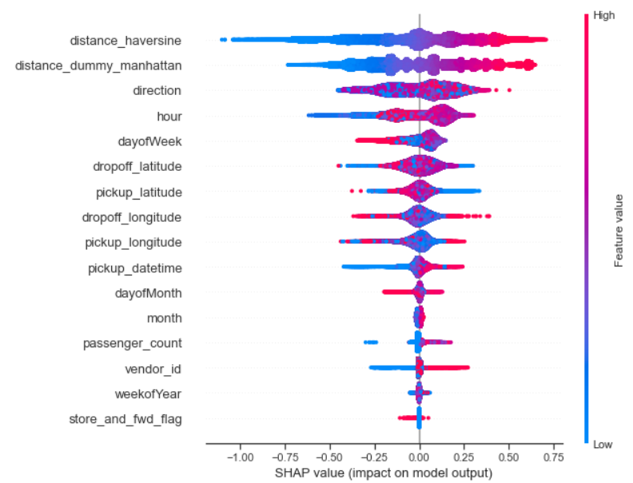
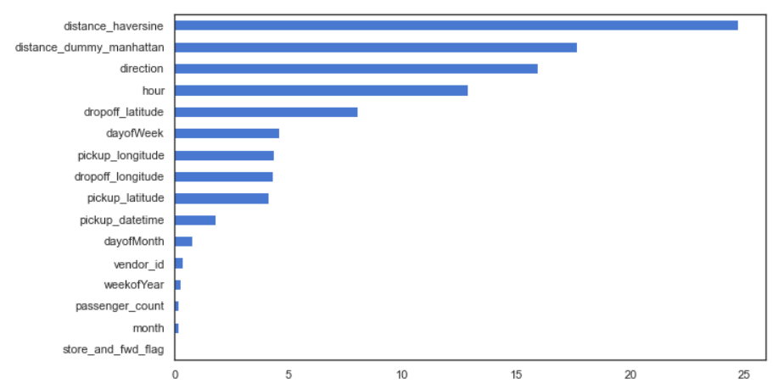
CatBoost Result
train | Test | MALE | MSLE | RMSLE
0.82 | 0.81 | 0.22 | 0.10 | 0.31

Slide 41
Conclusion

Slide 42
Conclusion
 | Train | Test | MALE | MSLE | RMSLE
LightGBM | 0.78 | 0.78 | 0.25 | 0.11 | 0.34
CatBoost | 0.82 | 0.82 | 0.22 | 0.10 | 0.31
We recommend, that CatBoost algorithm to solve in this case.

Slide 43

Thank You

Slide 44
SOURCE

Slide 45
Source:
https://www.kaggle.com/c/nyc-taxi-trip-duration/notebooks
https://catboost.ai/docs/concepts/about.html
https://lightgbm.readthedocs.io/en/latest/
http://www.nyc.gov/html/media/totweb/taxioftomorrow_history.html

